Slide 1
Stateless vs Stateful
Erton Ossandón

Slide 2
Stateless Rules
NET-VM
10.0.0.0/24
NET-FS
10.0.1.0/24
Egress
  Source 10.0.0.0/24
  Source Port All
  Destination 10.0.1.0/24
  Destination Port tcp: 111, 2048-2050
  udp: 111, 2048
Ingress
  Source 10.0.1.0/24
  Source Port tcp: 111, 2048-2050
  udp: 111, 2048
  Destination 10.0.0.0/24
  Destination Port All
Ingress
  Source 10.0.0.0/24
  Source Port All
  Destination 10.0.1.0/24
  Destination Port tcp: 111, 2048-2050
  udp: 111, 2048
Egress
  Source 10.0.1.0/24
  Source Port tcp: 111, 2048-2050
  udp: 111, 2048
  Destination 10.0.0.0/24
  Destination Port All

Slide 3
Stateful Rules
NET-VM
10.0.0.0/24
NET-FS
10.0.1.0/24
Egress
  Source 10.0.0.0/24
  Source Port All
  Destination 10.0.1.0/24
  Destination Port tcp: 111, 2048-2050
  udp: 111, 2048
Ingress
  Source 10.0.1.0/24
  Source Port tcp: 111, 2048-2050
  udp: 111, 2048
  Destination 10.0.0.0/24
  Destination Port All
Ingress
  Source 10.0.0.0/24
  Source Port All
  Destination 10.0.1.0/24
  Destination Port tcp: 111, 2048-2050
  udp: 111, 2048
Egress
  Source 10.0.1.0/24
  Source Port tcp: 111, 2048-2050
  udp: 111, 2048
  Destination 10.0.0.0/24
  Destination Port All
OCI Security Lists and Network Security Group use security rules available in two flavors: Stateful or Stateless. Stateful rules are the default, it provides a connection-tracked session between the source and destination IP address. This allows for ease of management and greater visibility of data flows between source and destination.

Slide 4
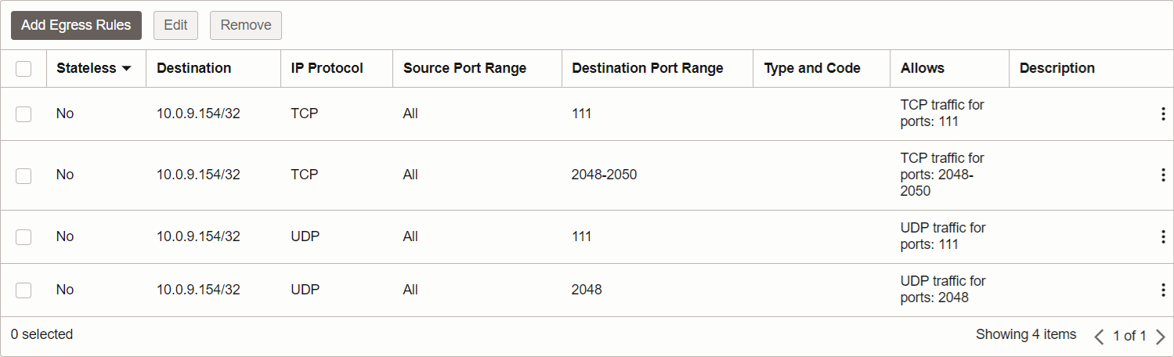
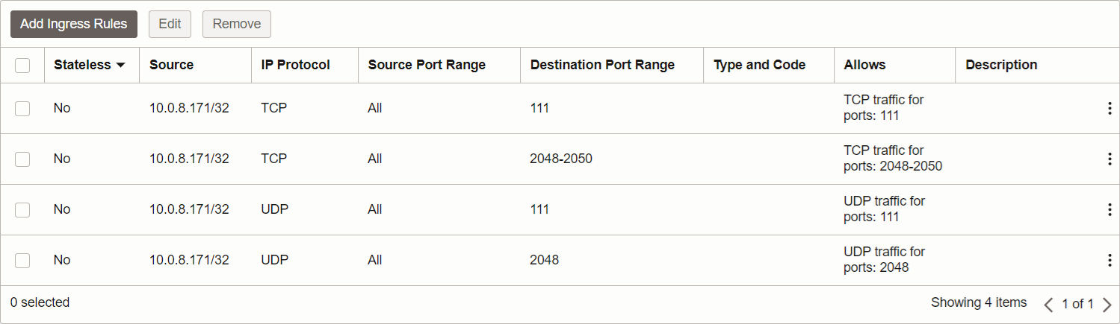
Use Case
net-bas-prd-phx-001
10.0.8.0/24
net-fss-prd-phx-001
10.0.9.0/24
Egress
  Source 10.0.8.171/32
  Source Port All
  Destination 10.0.9.154/32
  Destination Port tcp: 111, 2048-2050
  udp: 111, 2048
Ingress
  Source 10.0.8.171/32
  Source Port All
  Destination 10.0.9.154/32
  Destination Port tcp: 111, 2048-2050
  udp: 111, 2048

Slide 5
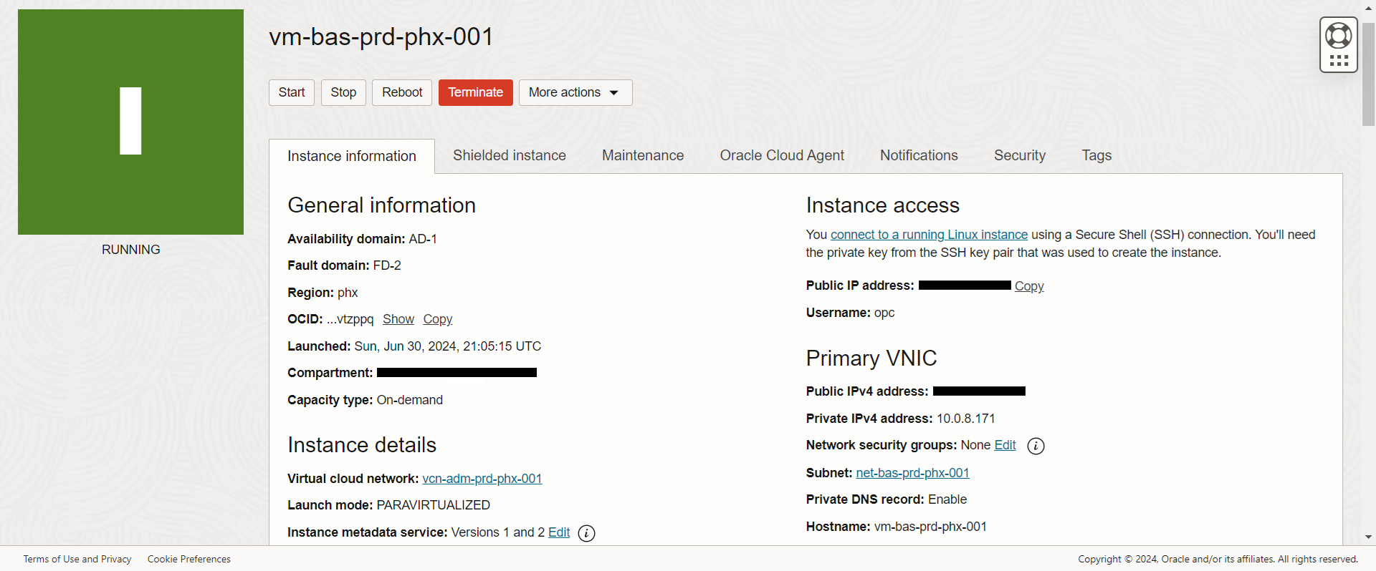
Instance (Oracle Linux)

Slide 6
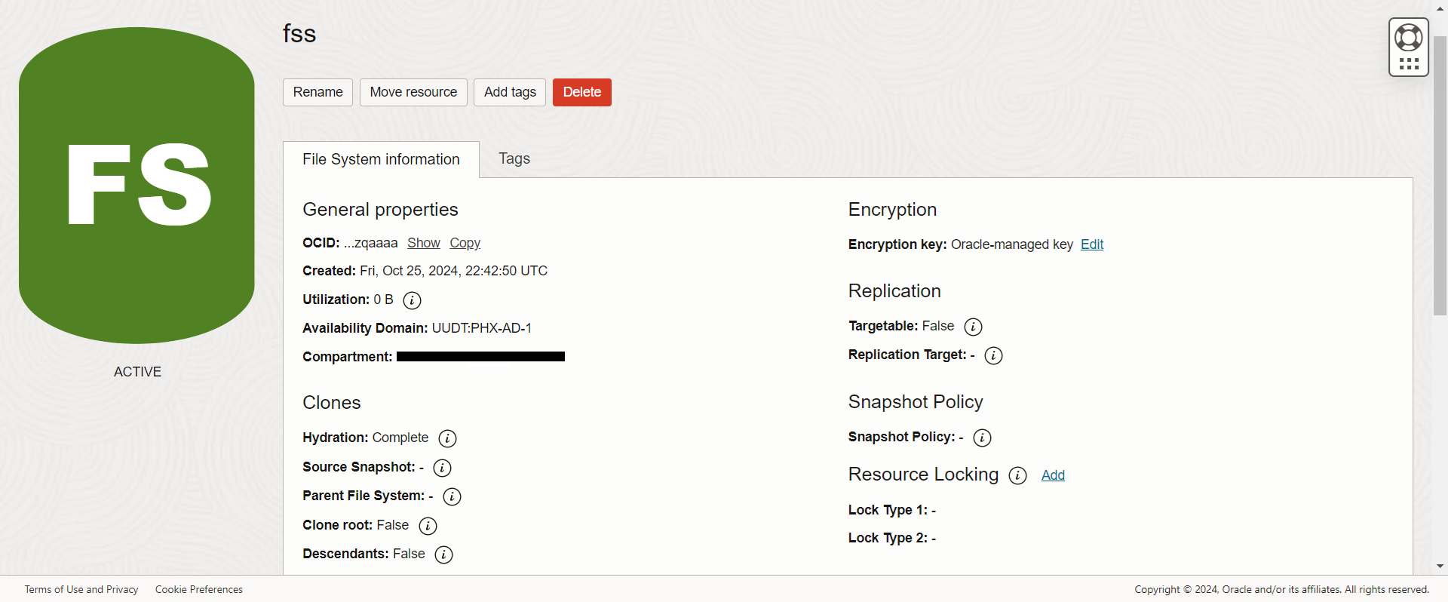
File Storage Service

Slide 7
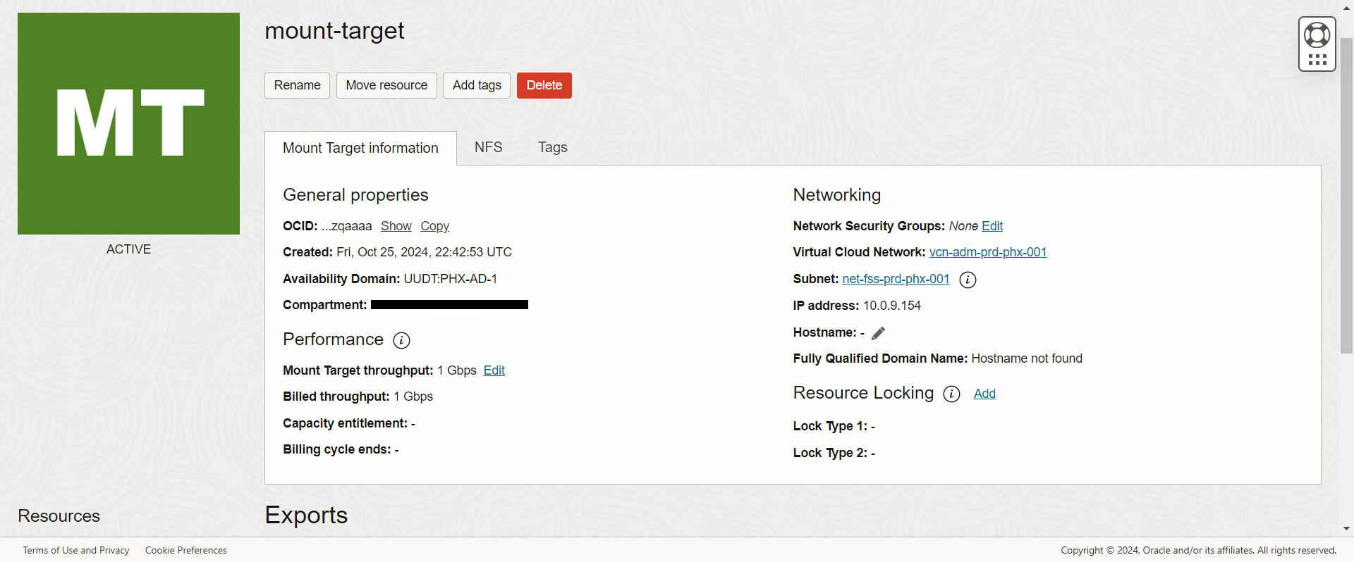
Mount Target

Slide 8
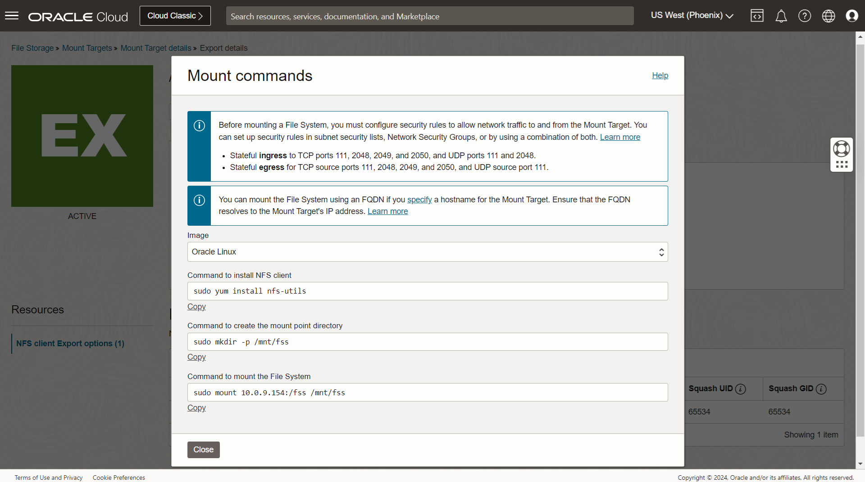
Mount Target Details

Slide 9
Egress Rules (Instance)

Slide 10
Ingress Rules (Mount Target)

Slide 11
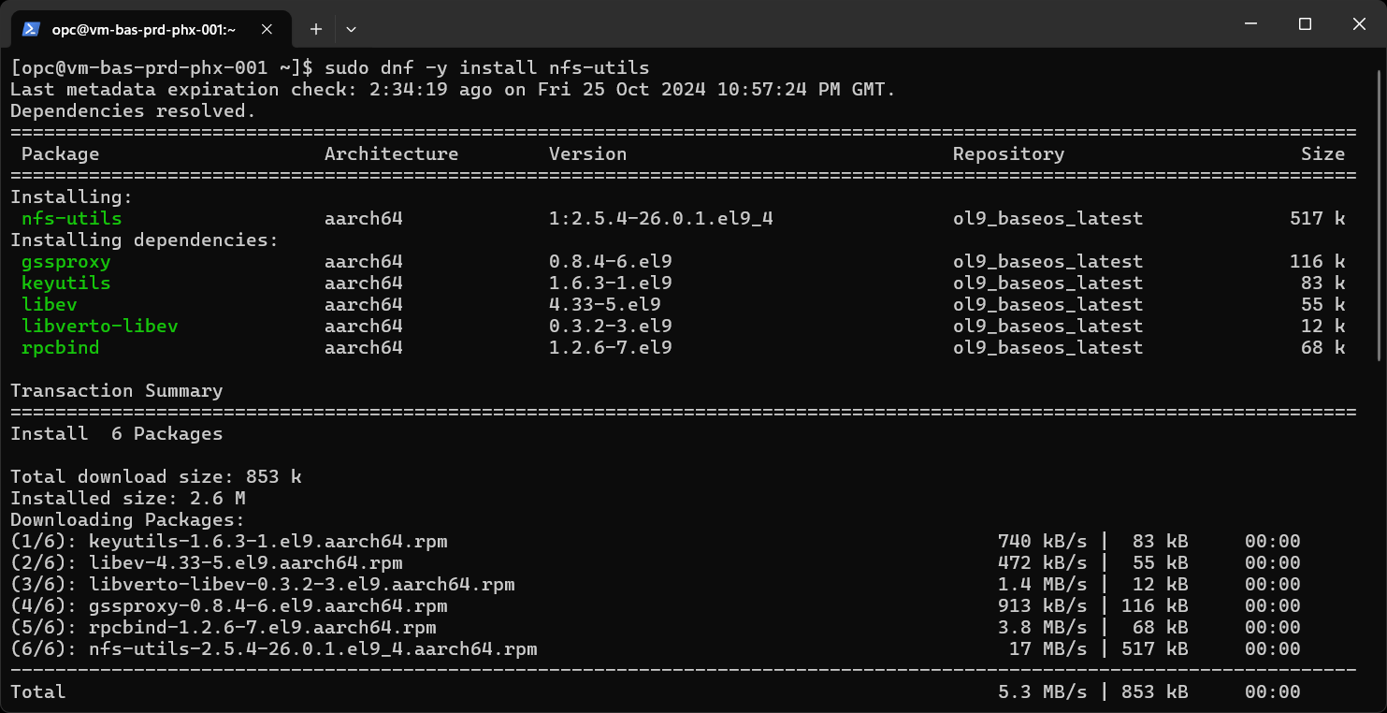
Commands

Slide 12
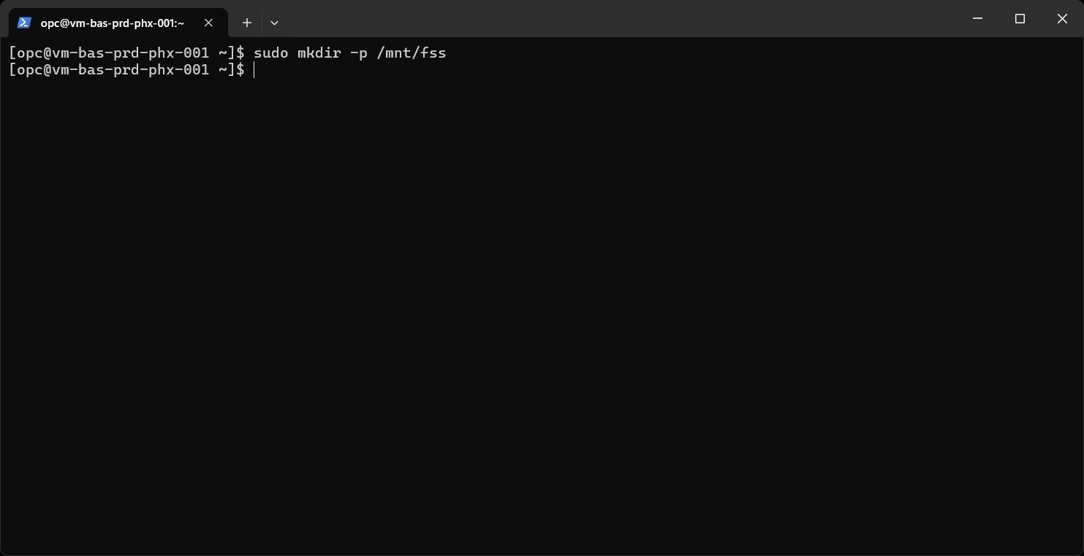
Commands

Slide 13
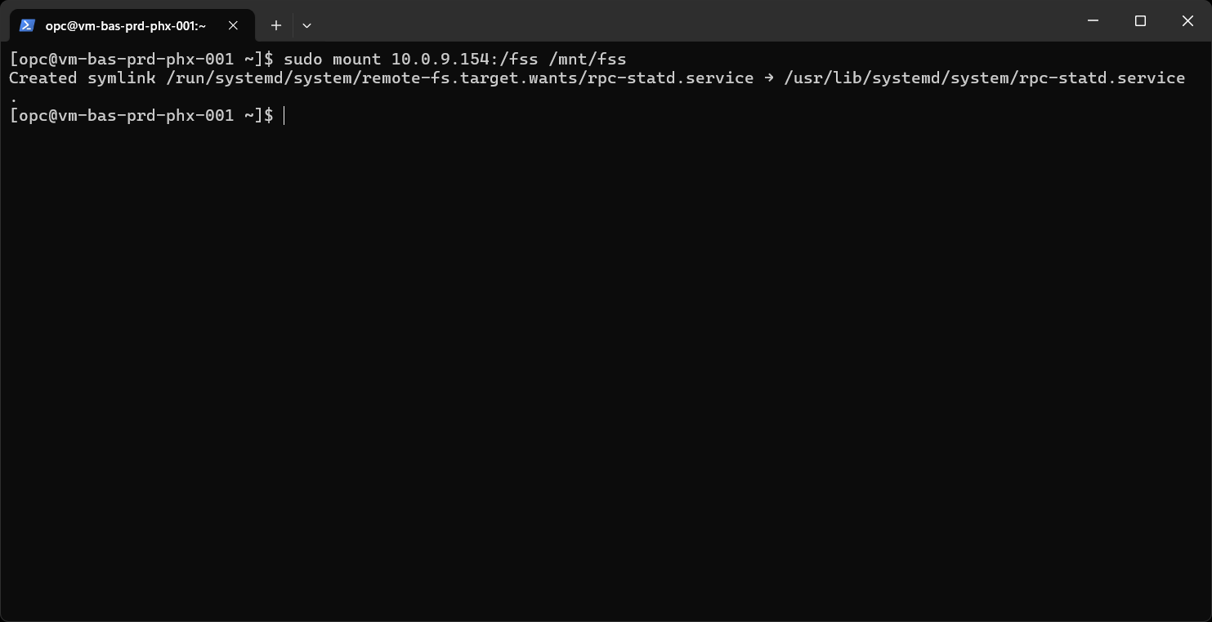
Commands

Slide 14
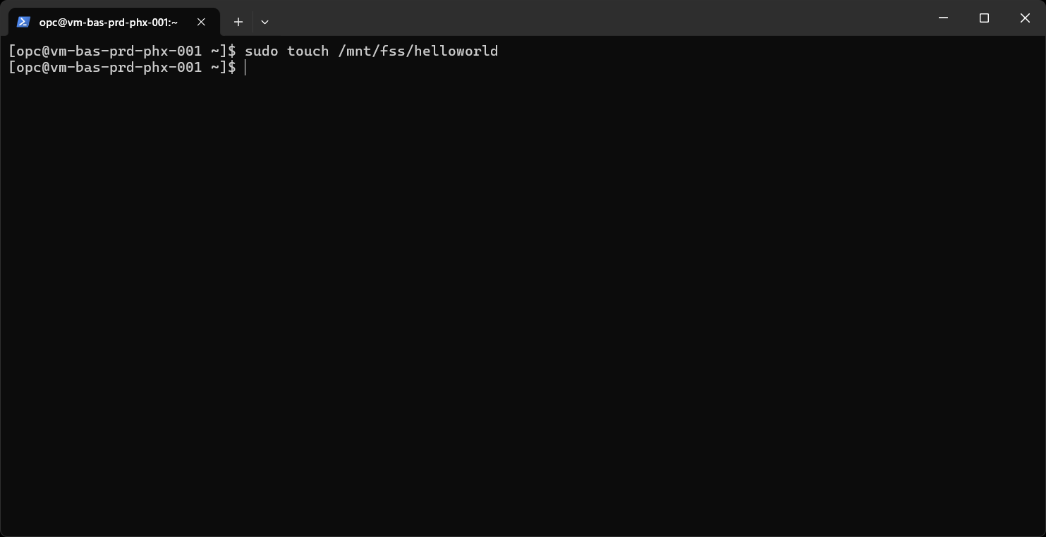
Commands

Slide 15
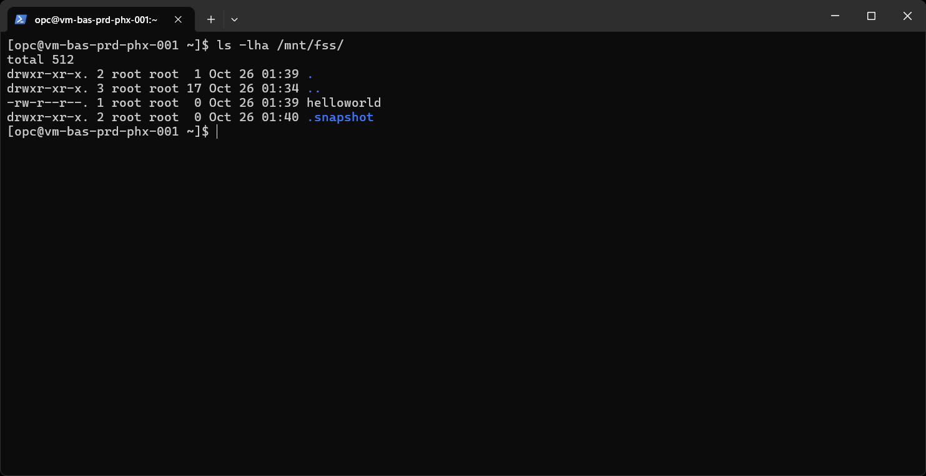
Commands

Slide 16
References
Security Rules and Monitoring Rule Events
https://www.ateam-oracle.com/post/security-rules-and-monitoring-rule-events
Configuring VCN Security Rules for File Storage
https://docs.oracle.com/en-us/iaas/Content/File/Tasks/securitylistsfilestorage.htm

Slide 17
Thank You
Erton Ossandón

